Slide 1
Capstone Project
IPL T20 Cricket Analysis
Team Members:- 1) Umang Wasekar 2)Ashutosh Kumar

Slide 2
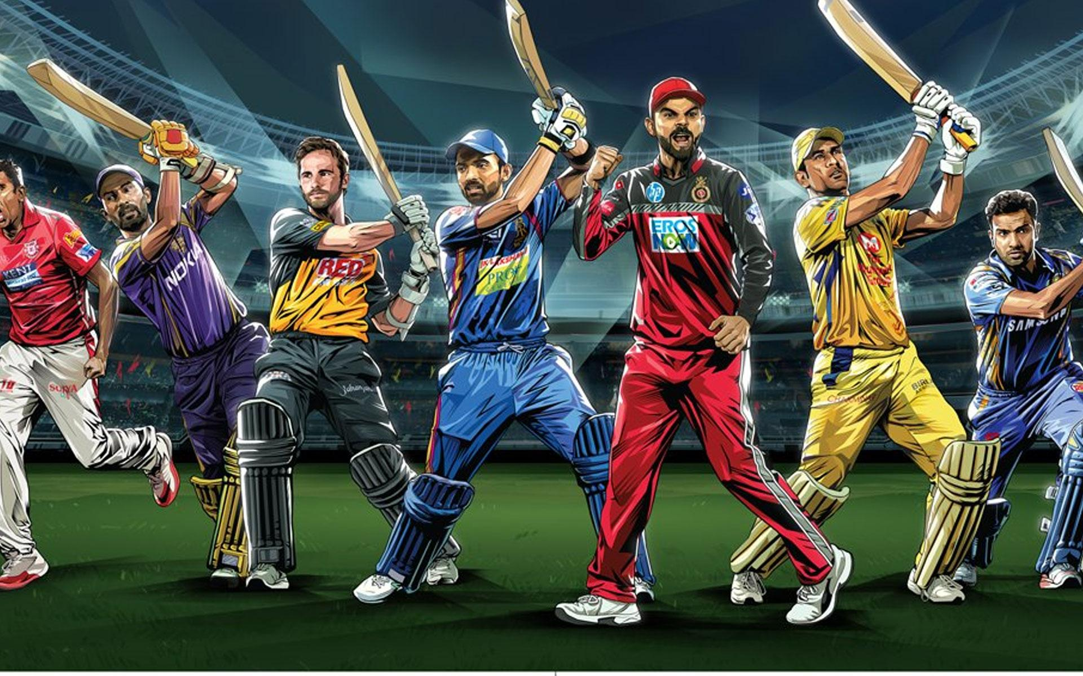
Presented by :-
Umang Washekar
Ashutosh Kumar

Slide 3
CONTENTS
INTRODUCTION
PROBLEM STATEMENT
HOME & AWAY PERFORMANCES
PLAYERWISE ANALYSIS
PLAYER ATTRIBUTES AND BELONGING NATIONS
DELIVERY WISE ANALYSIS
BOWLING FIGURES

Slide 4
INTRODUCTION

Slide 5
SUMMARY
IPL is a professional T20 league for T20 championship in India. It is supervised by BCCI whose headquarter is in Mumbai. Bollywood has also made its presence felt with two of its leading stars bagging the ownership of their respective teams. It has given a platform to Indian youngster to show their talent. Lot of players playing in IPL had played for India after performing in IPL. In IPL 8 teams play with each other to win the IPL trophy. So we are going to analyse the data of IPL to have an understanding that which teams and which players are performing well as well as how the how many Indian and foreign players have been debuted in IPL. We will also have a look on how the toss affects the result of match.

Slide 6
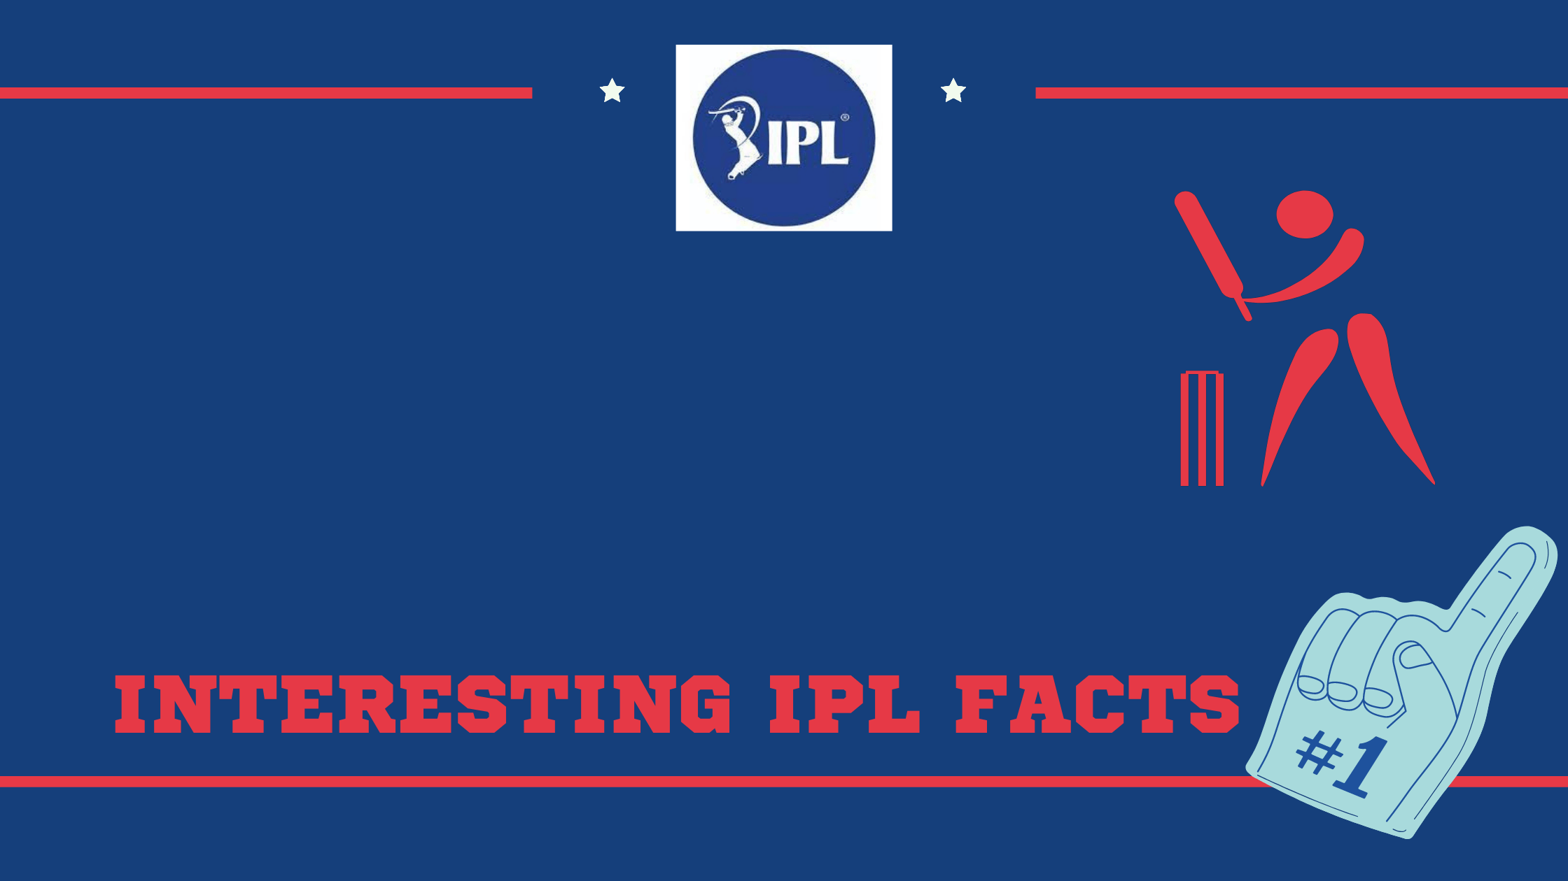

Slide 7
IPL FACTS
IPL is a professional T20 cricket league in India contested during April and May.
Team Names are Based on Indian cities.
It was founded by BCCI in 2008 and is now most attended cricket league in the world and ranks sixth among all sports league in India.
In 2010 the IPL became the first sporting league in world to be broadcasted live on YouTube.

Slide 8
PROBLEM STATEMENT

Slide 9
Problem Statement
IPL is a popular League in India. It is organised in year in month of April to May. And, we have different dataset of IPL on which we have to our analysis to find out the different outcomes of data in batting/ bowling performances of Individuals as well as of teams. We also have to analyse the teams performance at home venues as well as their performances on away from home venues.

Slide 10
HOME AND AWAY PERFORMANCES

Slide 11
HOME AND AWAY PERFORMANCES
We have been provided with the performance data of 13 teams that have participated right from season one to season ten.
Firstly, by using head() function on home_away_df we got all the data in readable format and there we analyzed the data carefully.
Then, by using unique() method on home_away_df we separated all the teams.
Visualizing the data helps in analyzing the data more clearly and it is way more easier to understand it by seeing data rather than just reading it.
Below is the data snapshots that we worked on and analyzed all the data and plotted the graphs with the help of it.

Slide 12
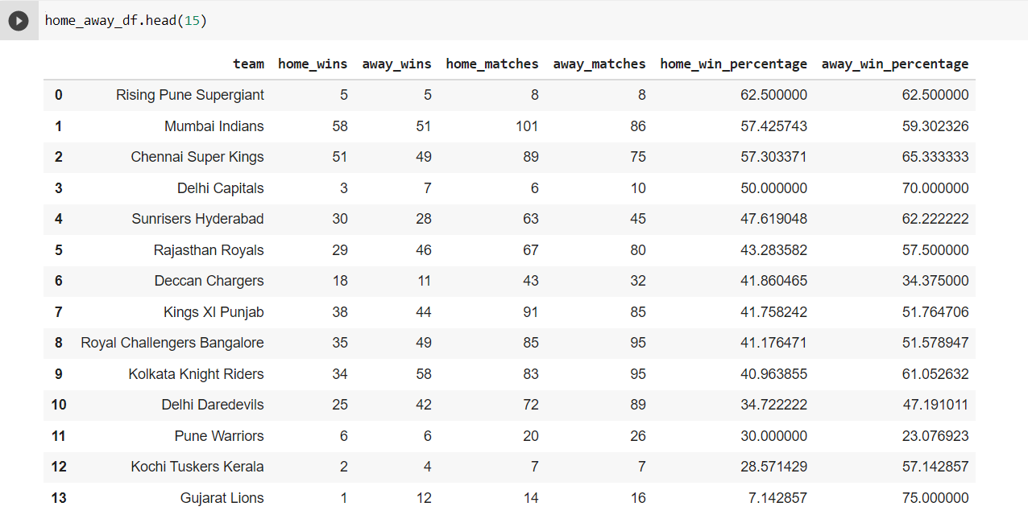
DATA SNAPSHOT

Slide 13
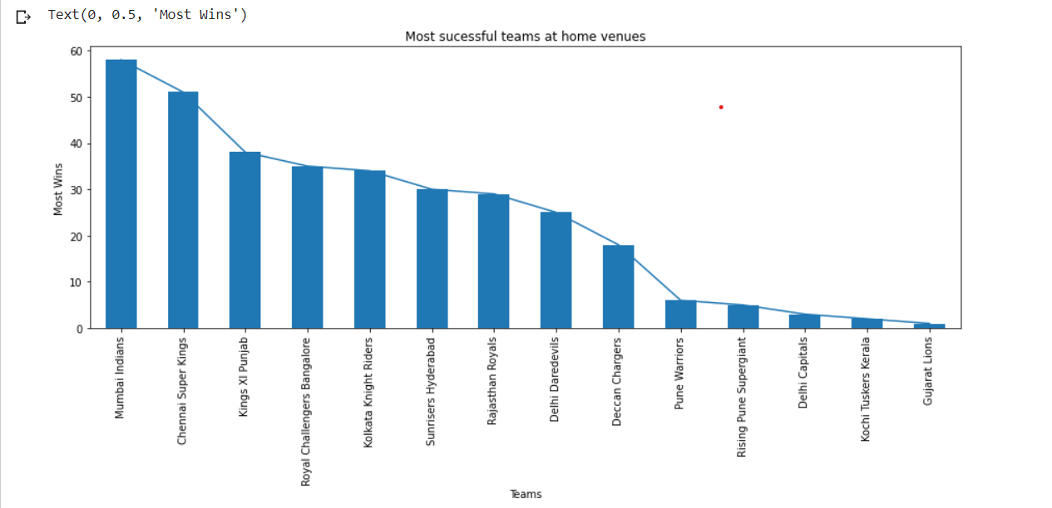
PERFORMANCES OF ALL THE TEAMS AT HOME VENUES

Slide 14
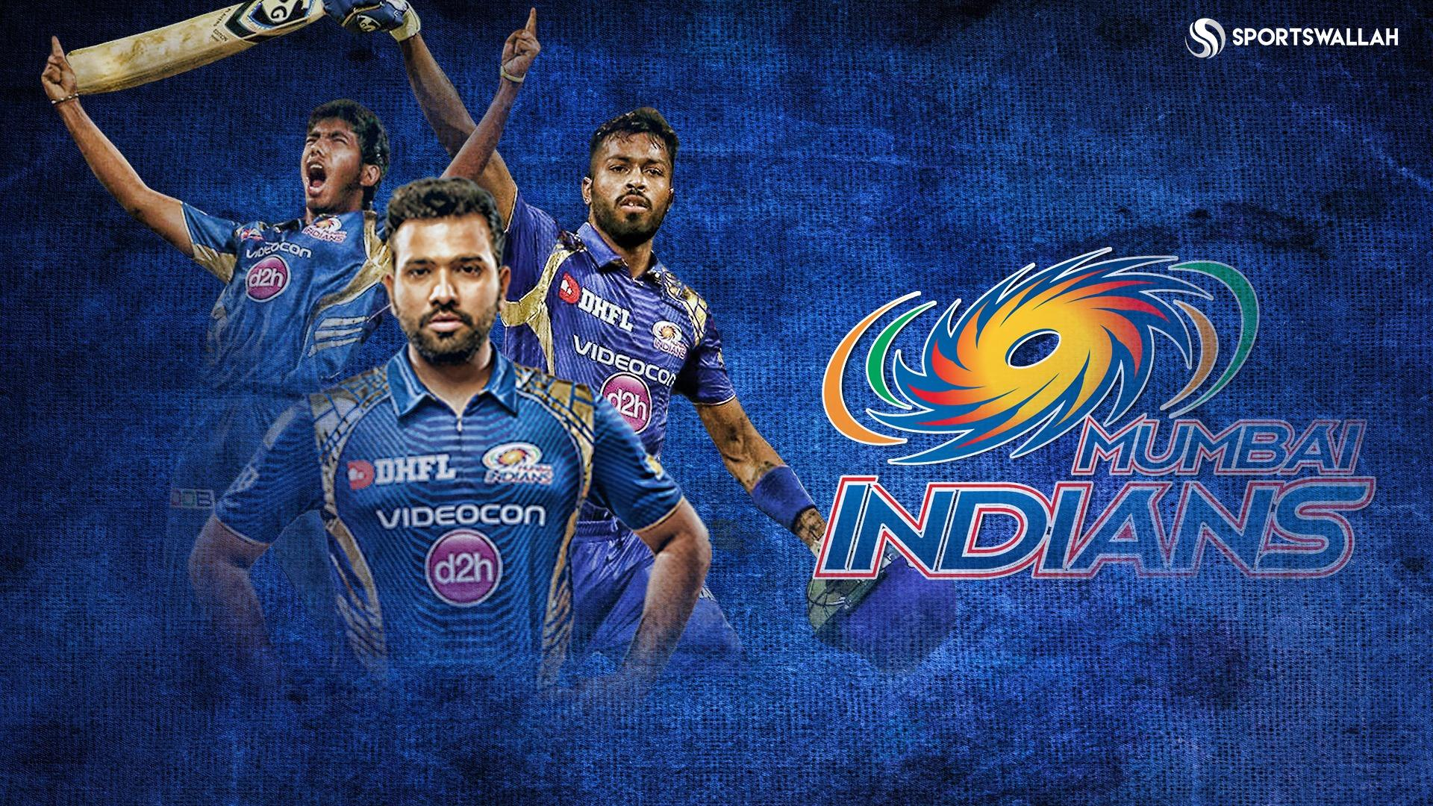

Slide 15
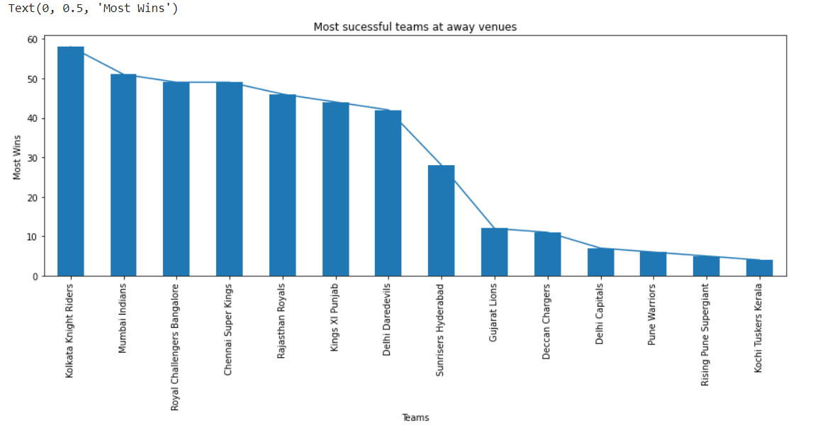
PERFORMANCES OF ALL THE TEAMS AT AWAY VENUES

Slide 16
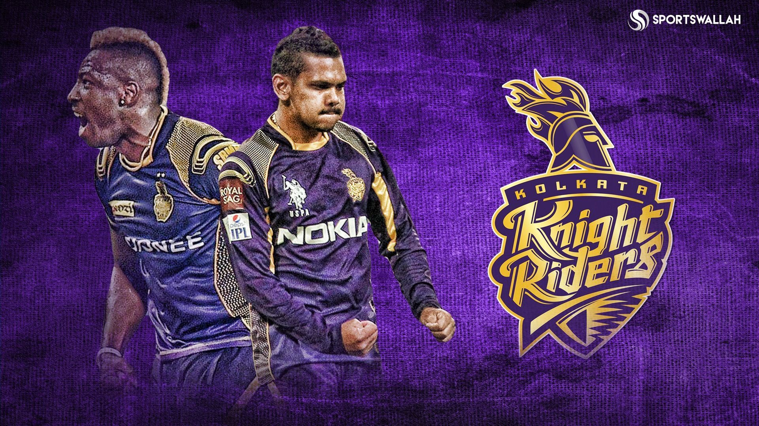

Slide 17
KEY POINTS FROM THE PLOTS
From the first plot we can see that the Mumbai Indians were the most successful team in taking advantage of home conditions with total of 58 wins in their 101 matches, followed by Chennai Super Kings and KXIP (now PBKS) at 51 and 38 respectively.
Whereas, Gujrat Lions were the least successful team to do the same with only 1 win in their 14 home games.
Now, coming to the second plot, which is about the team performing well in away conditions.
Here, Kolkata Knight Riders tops the list the with total of 58 wins in their 95 matches.
On the contrary, Kochi Tuskers Kerala only registered 4 wins in their 7 league games.

Slide 18
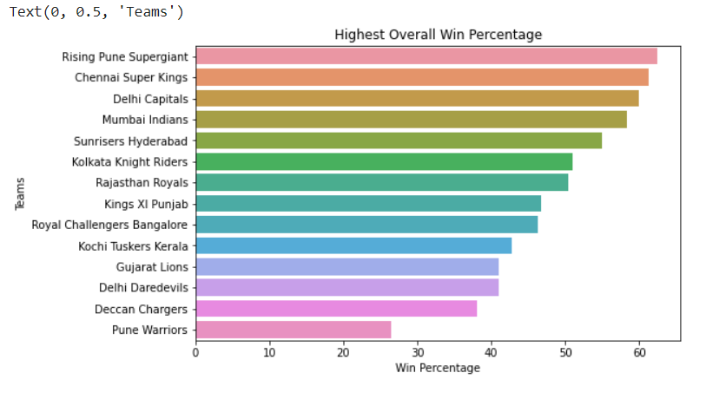
HIGHEST OVERALL WIN PERCENTAGE TEAMWISE

Slide 19
KEY POINTS FROM THE PLOTS
The above plot depicts the graphical representation of teams who performed well overall in their tenure.
It can be seen that Rising Pune Supergiants has the highest overall win percentage amongst all with average overall win percentage of 62.5 followed by CSK with 61%(appx) and whereas Pune Warriors stands on the bottom with overall win percentage of 26%(appx).

Slide 20
PLAYER WISE ANALYSIS

Slide 21
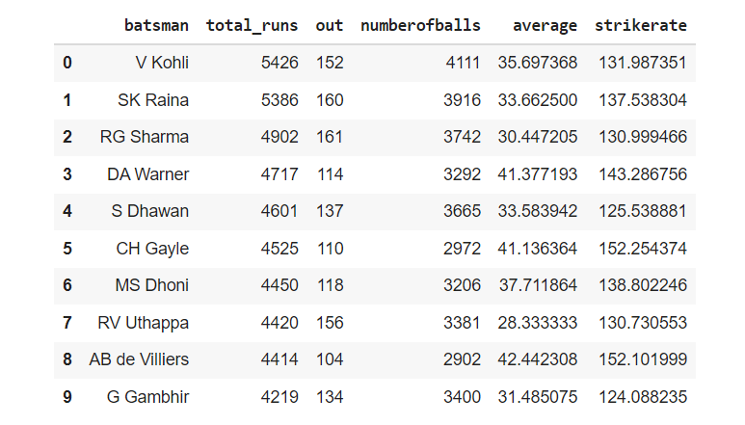
DATA SNAPSHOT

Slide 22
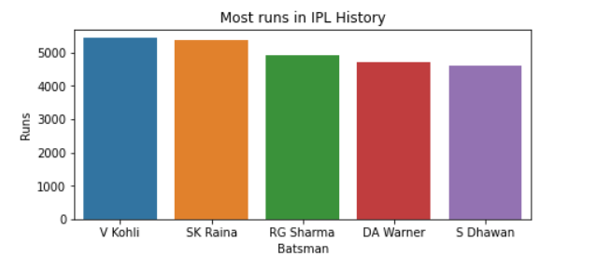
TOP 5 HIGHEST RUNS SCORER IN IPL HISTORY
The graph shows the pictorial representation of top 5 players who scored most runs in history of IPL.
Virat Kohli tops this list with 5426 runs just 40 runs ahead of the second most run scorer i.e. Suresh Raina with the total of 5386 runs scored in entire IPL career.
Indian players dominating in top 5 with only one overseas player i.e. David Warner who is 4th highest run scorer in IPL.

Slide 23
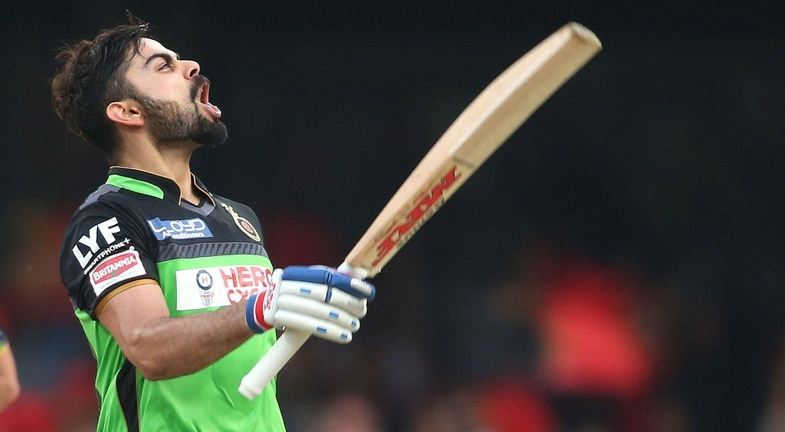

Slide 24
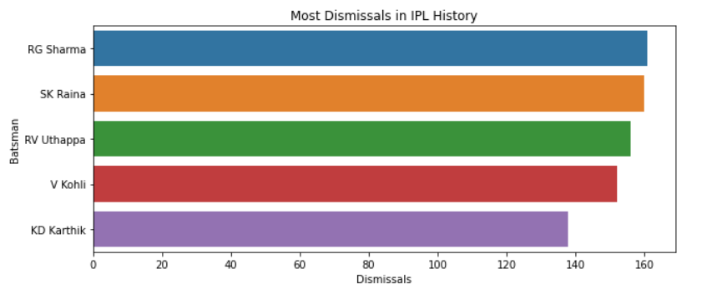
PLAYERS WITH MOST DISMISSALS IN IPL HISTORY
This graph depicts the top 5 players with most number of dismissals in IPL.
Rohit Sharma got dismissed on 161 occasions which is the most, followed by Suresh Raina with 160 dismissals.
This list is also dominated by Indian players with all top 5 who got dismissed the most times are Indians.

Slide 25
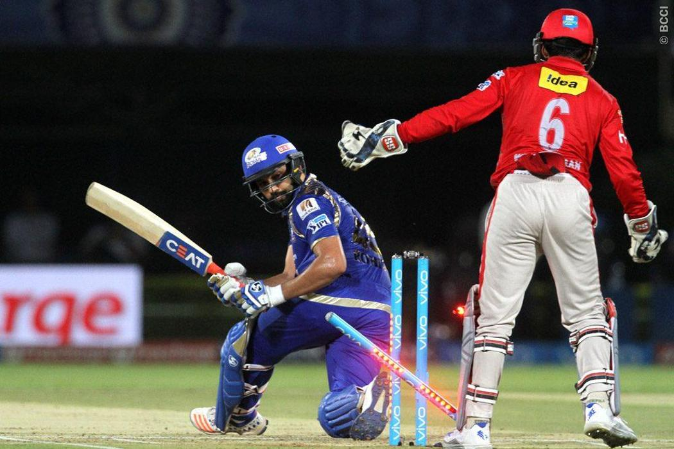

Slide 26
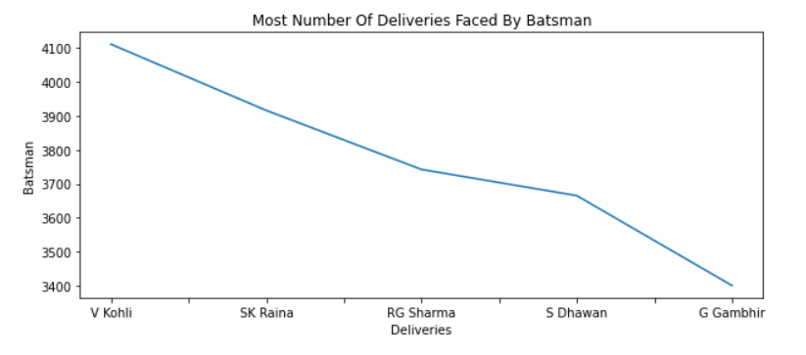
PLAYERS WHO FACED MOST NUMBERS OF DELIVERIES
This line plot depicts the top 5 batsmen who faced most number of deliveries in IPL.
It can be seen that 4111 deliveries faced by Virat Kohli are the most number of deliveries faced by any batsman in IPL till now.
Virat, Suresh and Rohit has faced the most number of deliveries in IPL history.

Slide 27
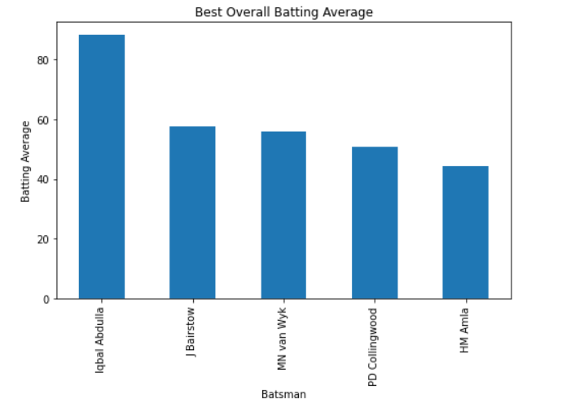
Top 5 players with highest Batting average
This bar graph represents the players with highest batting average in IPL career.
Surprisingly, Iqbal Abdulla leading the list with overall career batting average of 86(appx).
J Bairstow and HM Amla are the two openers in the list , followed by van Wyk and Paul Collingwood which are all rounders.

Slide 28
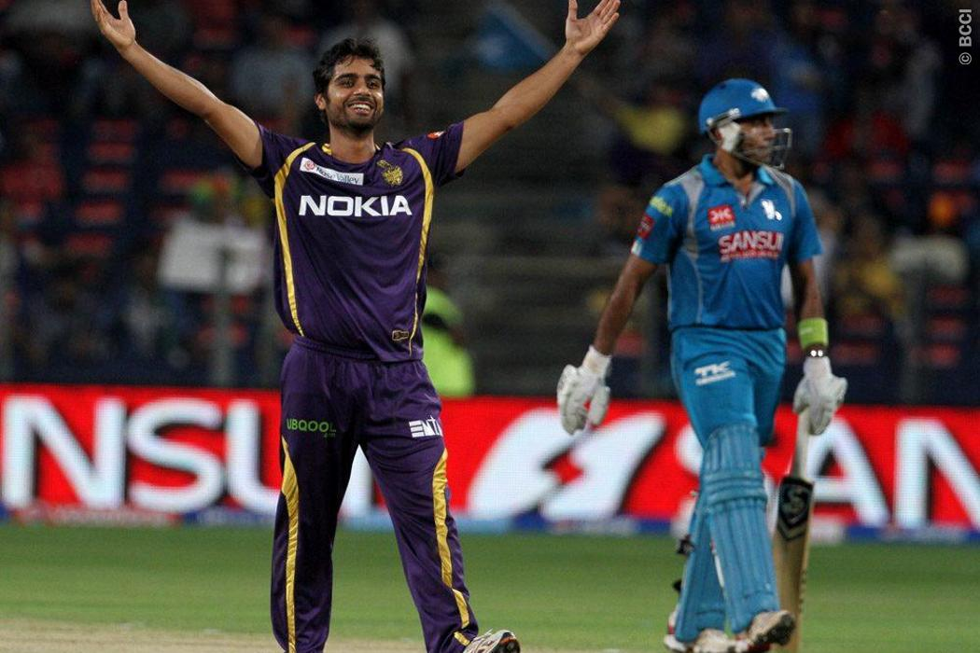

Slide 29
PLAYER ATTRIBUTES AND BELONGING NATIONS

Slide 30
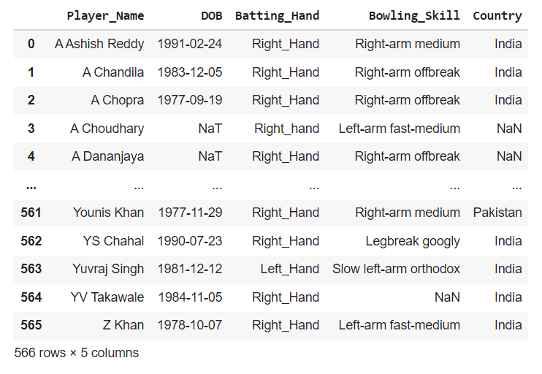
DATA SNAPSHOT

Slide 31
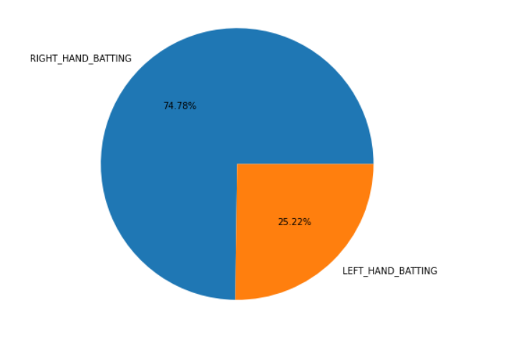
COMPARISON OF LEFT HAND, RIGHT HAND BATSMEN IN IPL
The pie chart depicts the percentage difference between the right handed batsmen to the left handed batsmen that has debuted in IPL till now.
It can be seen that, almost 3/4th of the batsmen are right handed while only 1/4th have left dominant hand.

Slide 32
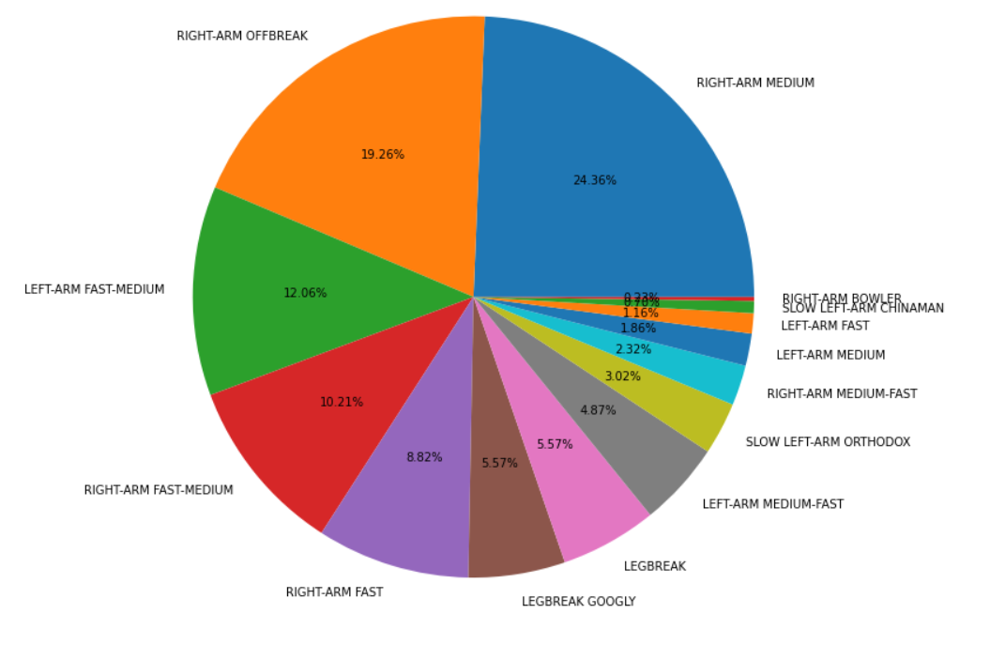
BOWLING SKILLS (FREQUENTLY USED VARIATIONS )

Slide 33
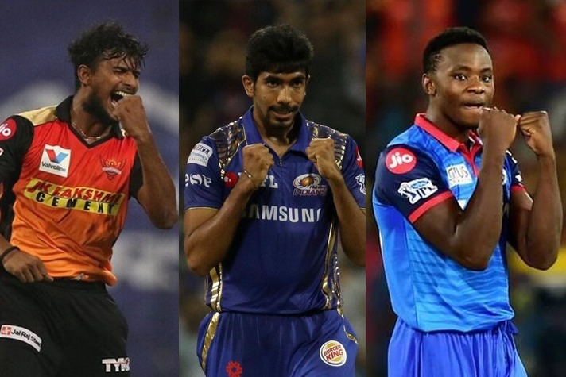

Slide 34
CONTINUED..
Right Arm Off-break and Right Arm Medium constitutes for almost 42% of total bowlers.
Around 1/4th of bowlers are Left Arm Fast Medium and Right Arm Fast Medium pacers.
Only 0.20% of bowlers are basic Right Arm Bowler, followed by second least which is Slow Left Arm Chinaman ,at 0.80%

Slide 35
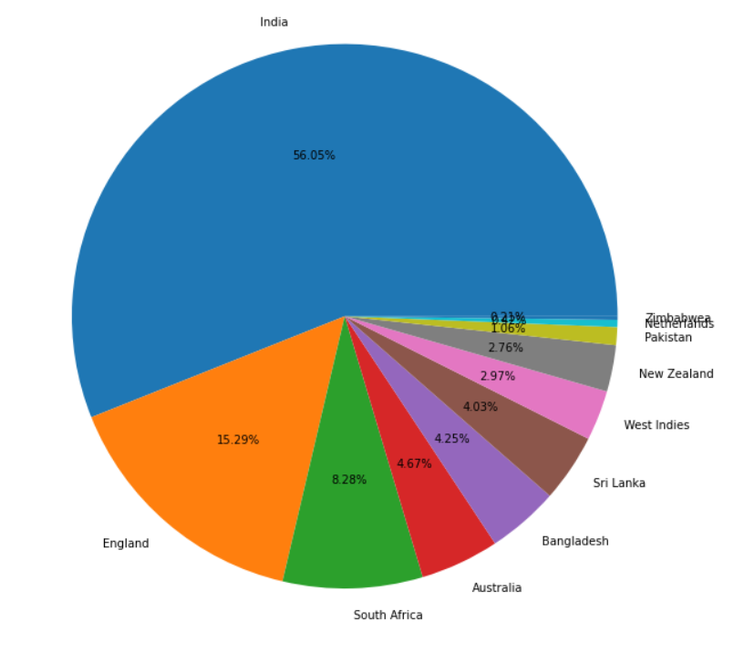
COMPARISON OF NUMBER OF PLAYERS DEBUTED FROM EACH NATION
There is no surprise that India constitutes for almost half of the total debuted players, there’s a reason why its called INIDAN PREMIER LEAGUE.
England is the 2nd highest contributor of the players with sum of 15.29% debuts, followed by Australia with 8.28%.
On the contrary, only 0.21% of players have participated from Zimbabwe which is the least amongst all the nations.

Slide 36
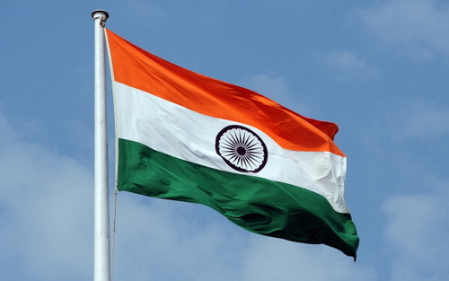

Slide 37
DELIVERY WISE ANALYSIS

Slide 38
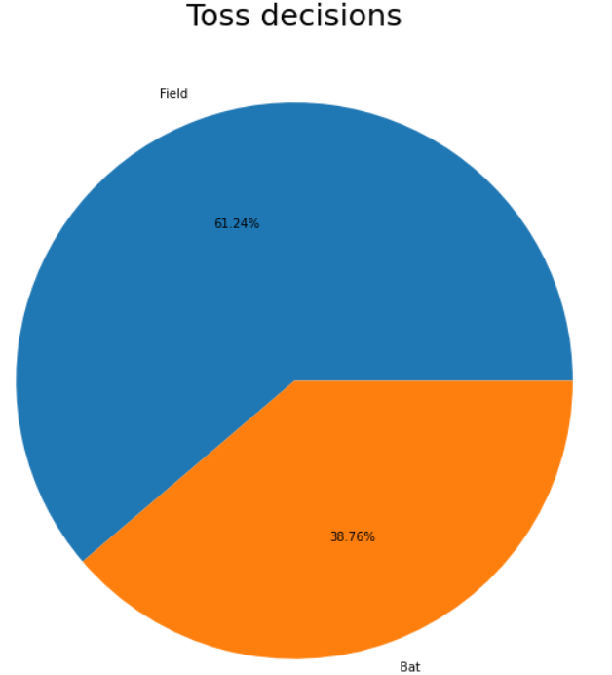
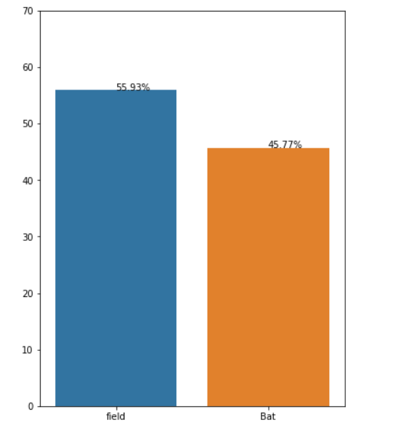
TEAM DECISION AFTER WINNING TOSS

Slide 39
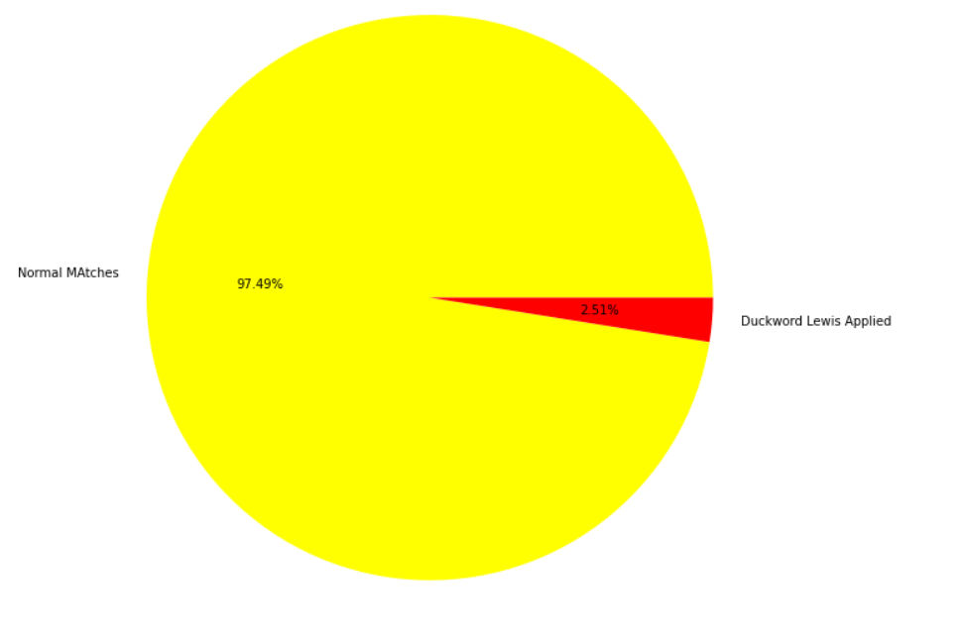
RAIN AFFECTED MATCHES

Slide 40
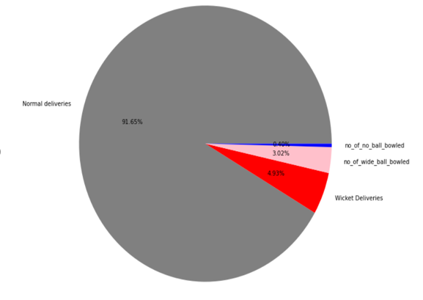
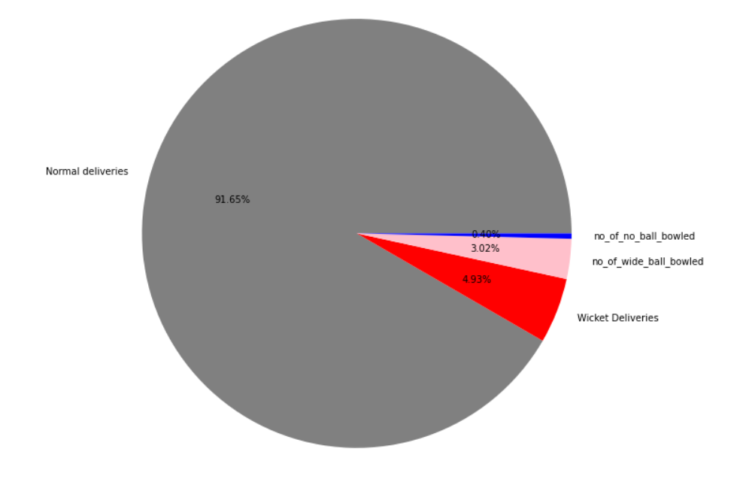
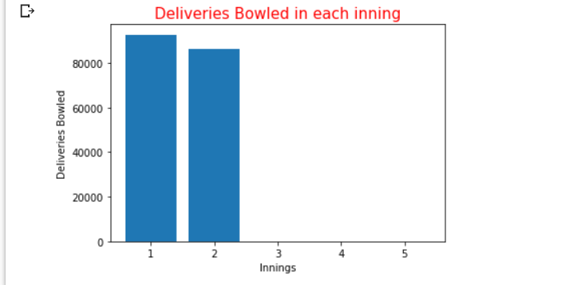
ANALYSIS OF DELIVERIES

Slide 41
BOWLING FIGURES

Slide 42
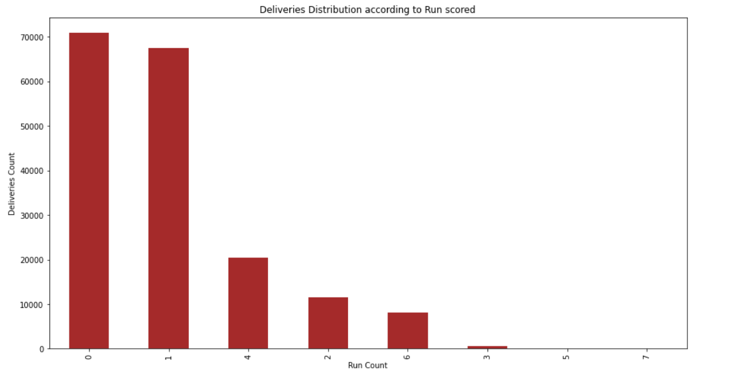
Runs Scored on Balls

Slide 43
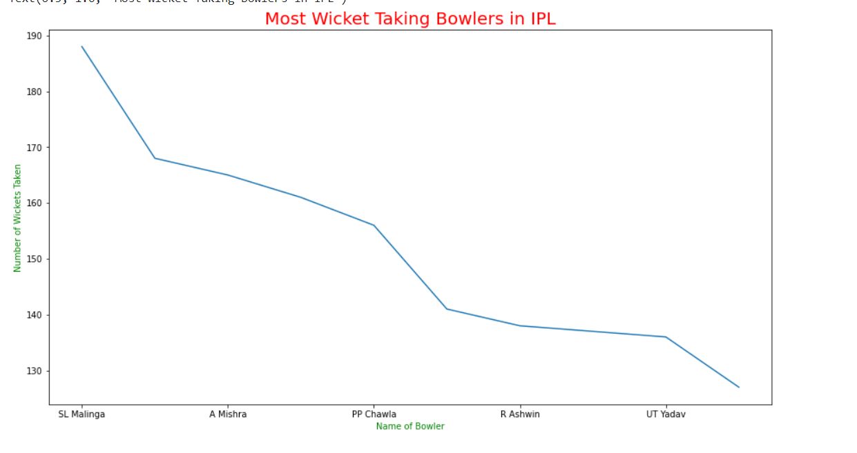
Bowling Figures

Slide 44
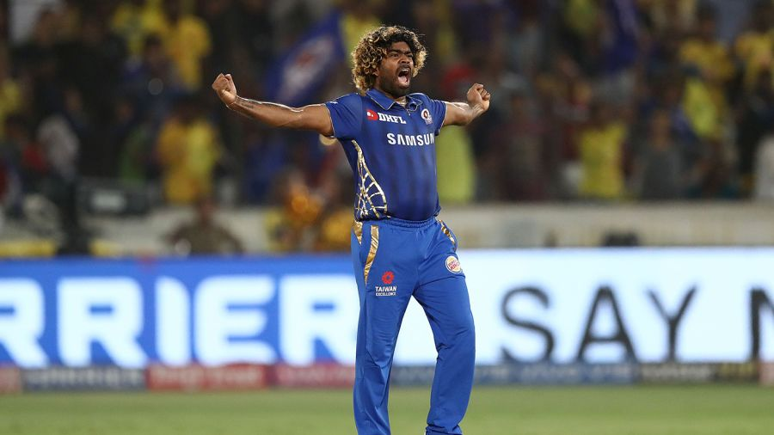

Slide 45
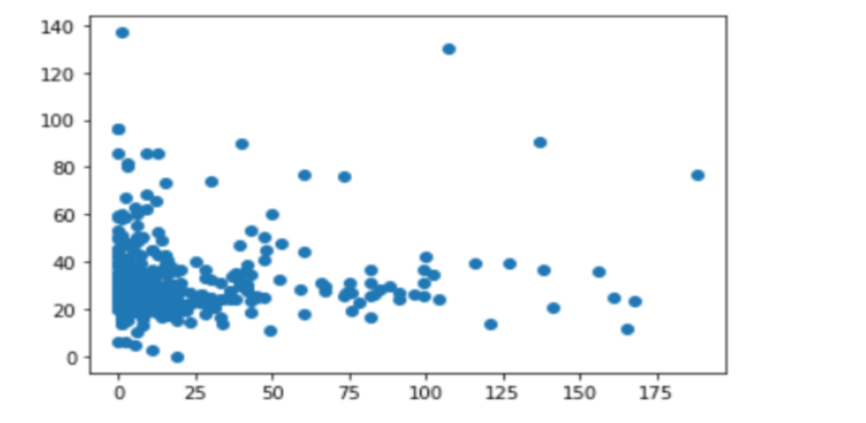
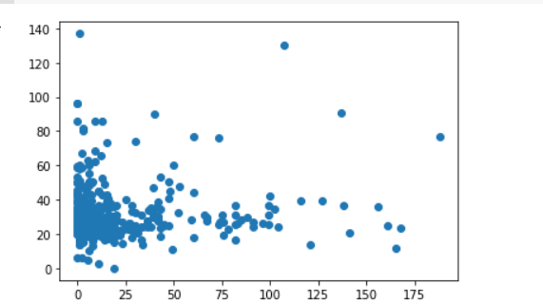
BOWLING FIGURES CONTINUED…

Slide 46
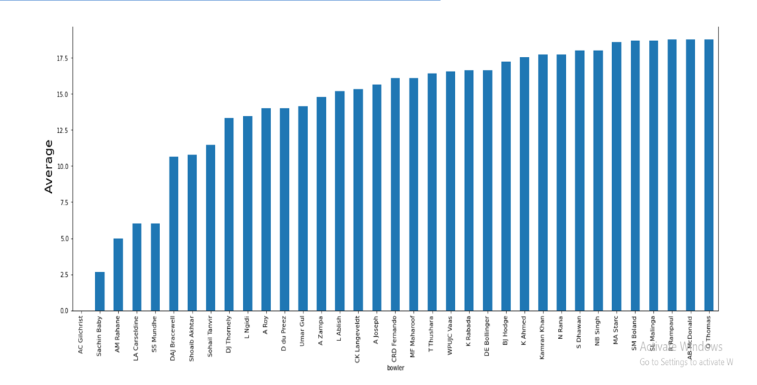
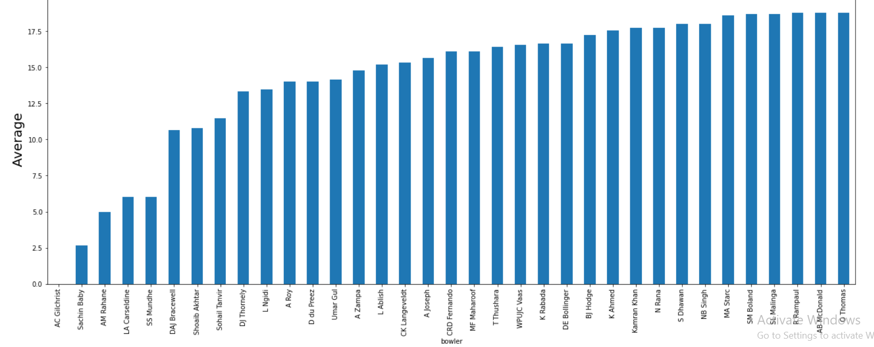
BOWLING FIGURES CONTINUED….

Slide 47
CONCLUSION
Side who had won the toss has opted to field first comparatively more times than to bat.
Mumbai Indians is the most successful team in the history of IPL.
Virat Kohli, Suresh Raina, Rohit Sharma are dominating in all the batting records.
Lasith Malinga, K Rabada, K Ahmed , R Ashwin are key bowlers.
Almost, 3/4th of the batsmen are right handed while only 1/4th have left dominant hand.

Slide 48


